Slide 1
This time: Fuzzy Logic and Fuzzy Inference
Why use fuzzy logic?
Tipping example
Fuzzy set theory
Fuzzy inference

Slide 2
What is fuzzy logic?
A super set of Boolean logic
Builds upon fuzzy set theory
Graded truth. Truth values between True and False. Not everything is either/or, true/false, black/white, on/off etc.
Grades of membership. Class of tall men, class of far cities, class of expensive things, etc.
Lotfi Zadeh, UC/Berkely 1965. Introduced FL to model uncertainty in natural language. Tall, far, nice, large, hot, …
Reasoning using linguistic terms. Natural to express expert knowledge.
If the weather is cold then wear warm clothing

Slide 3
Why use fuzzy logic?
Pros:
Conceptually easy to understand w/ “natural” maths
Tolerant of imprecise data
Universal approximation: can model arbitrary nonlinear functions
Intuitive
Based on linguistic terms
Convenient way to express expert and common sense knowledge
Cons:
Not a cure-all
Crisp/precise models can be more efficient and even convenient
Other approaches might be formally verified to work

Slide 4
Tipping example
The Basic Tipping Problem: Given a number between 0 and 10 that represents the quality of service at a restaurant what should the tip be?
Cultural footnote: An average tip for a meal in the U.S. is 15%, which may vary depending on the quality of the service provided.

Slide 5
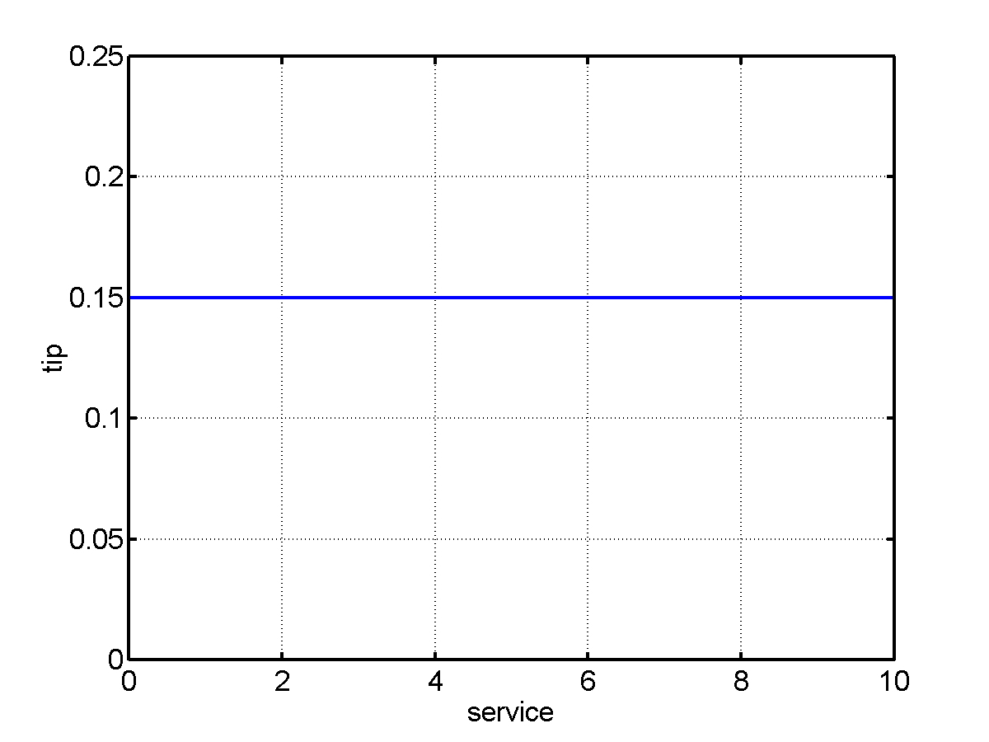
Tipping example: The non-fuzzy approach
Tip = 15% of total bill
What about quality of service?

Slide 6
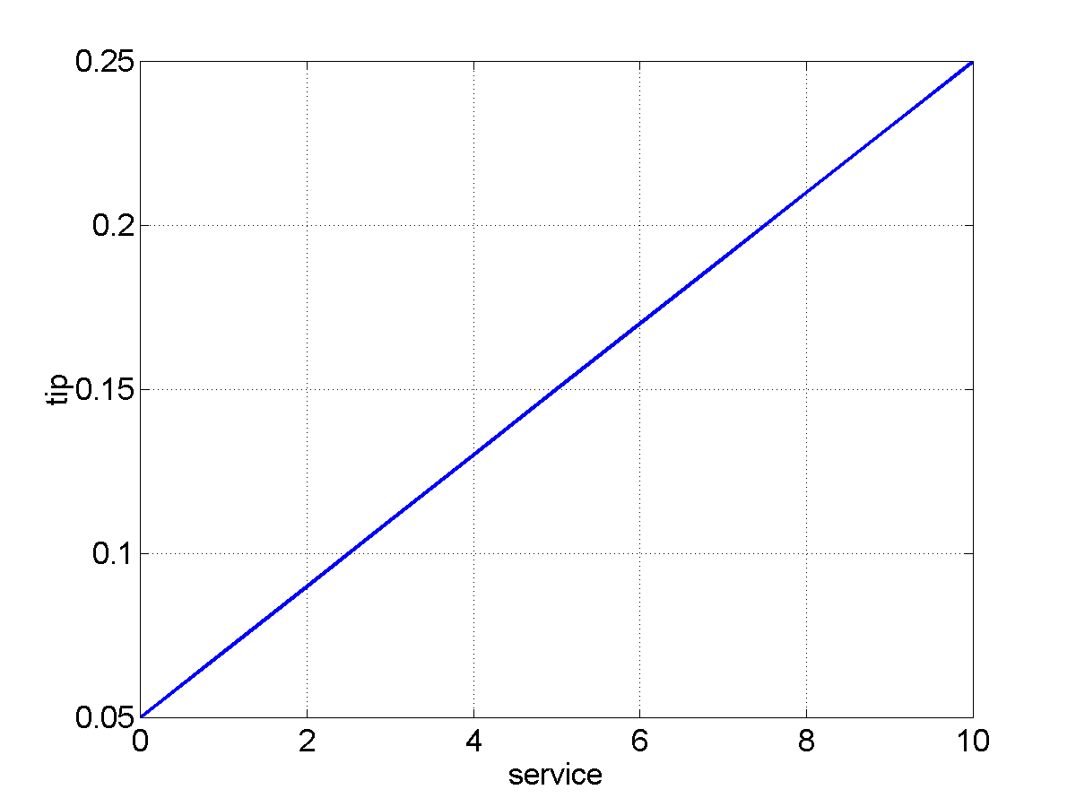
Tipping example: The non-fuzzy approach
Tip = linearly proportional to service from 5% to 25%
tip = 0.20/10*service+0.05
What about quality of the food?

Slide 7
Tipping example: Extended
The Extended Tipping Problem: Given a number between 0 and 10 that represents the quality of service and the quality of the food, at a restaurant, what should the tip be?
How will this affect our tipping formula?

Slide 8
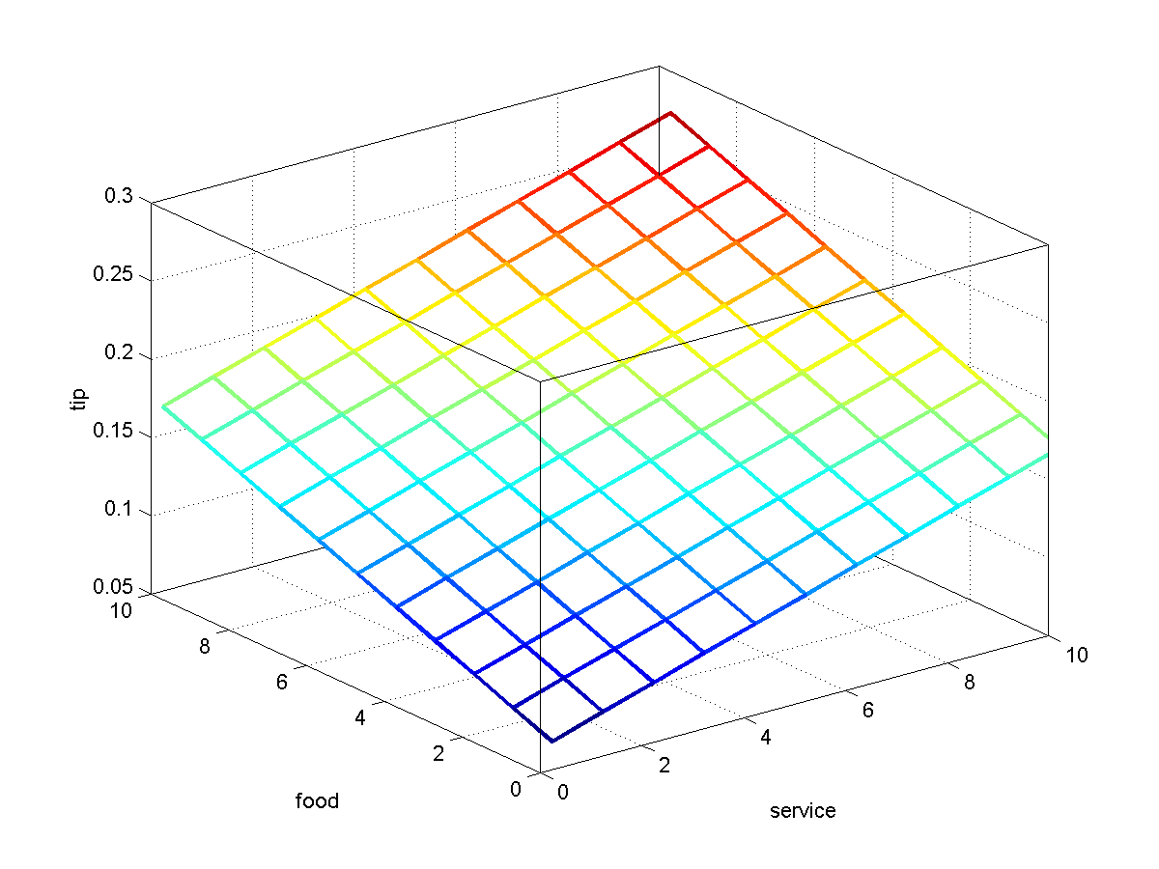
Tipping example: The non-fuzzy approach
Tip = 0.20/20*(service+food)+0.05
We want service to be more important than food quality. E.g., 80% for service and 20% for food.

Slide 9
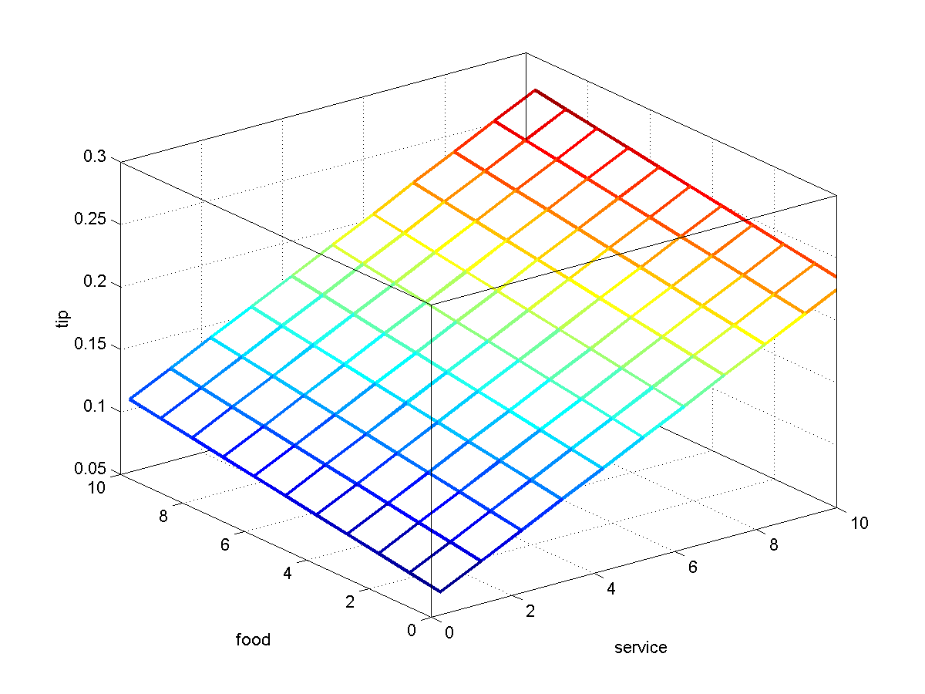
Tipping example: The non-fuzzy approach
Tip = servRatio*(.2/10*(service)+.05) + servRatio = 80%
(1-servRatio)*(.2/10*(food)+0.05);
Seems too linear. Want 15% tip in general and deviation only for exceptionally good or bad service.

Slide 10
Tipping example: The non-fuzzy approach
if service < 3,
tip(f+1,s+1) = servRatio*(.1/3*(s)+.05) + ... (1-servRatio)*(.2/10*(f)+0.05);
elseif s < 7,
tip(f+1,s+1) = servRatio*(.15) + ...
(1-servRatio)*(.2/10*(f)+0.05);
else,
tip(f+1,s+1) = servRatio*(.1/3*(s-7)+.15) + ...
(1-servRatio)*(.2/10*(f)+0.05);
end;

Slide 11
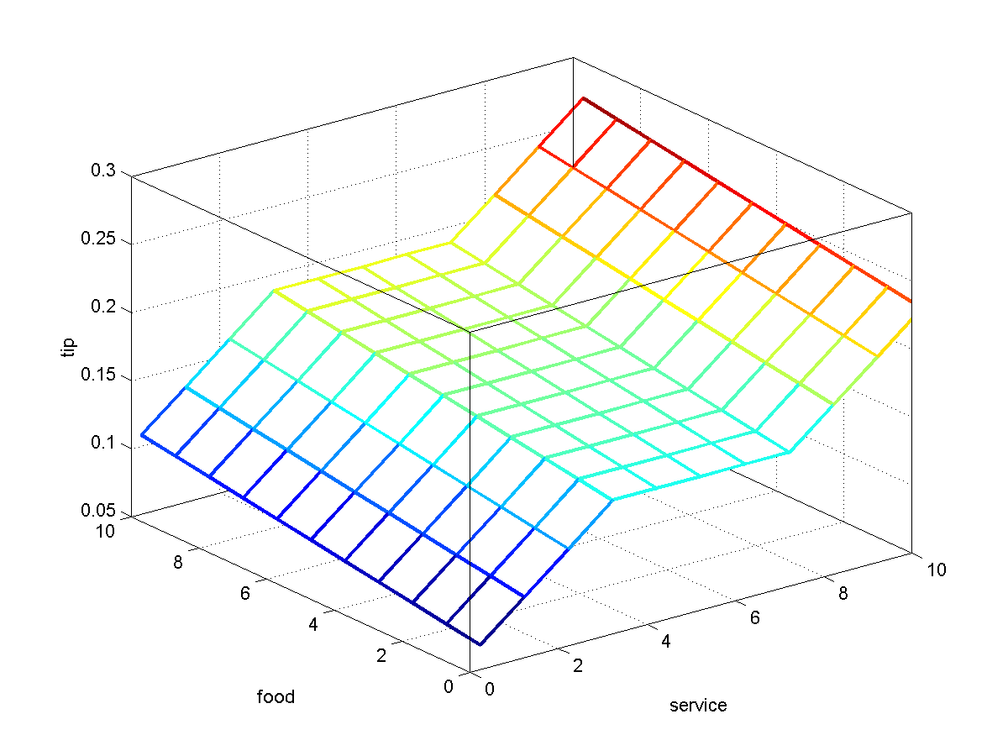
Tipping example: The non-fuzzy approach
Nice plot but
‘Complicated’ function
Not easy to modify
Not intuitive
Many hard-coded parameters
Not easy to understand

Slide 12
Tipping problem: the fuzzy approach
What we want to express is:
If service is poor then tip is cheap
If service is good the tip is average
If service is excellent then tip is generous
If food is rancid then tip is cheap
If food is delicious then tip is generous
or
If service is poor or the food is rancid then tip is cheap
If service is good then tip is average
If service is excellent or food is delicious then tip is generous
We have just defined the rules for a fuzzy logic system.

Slide 13
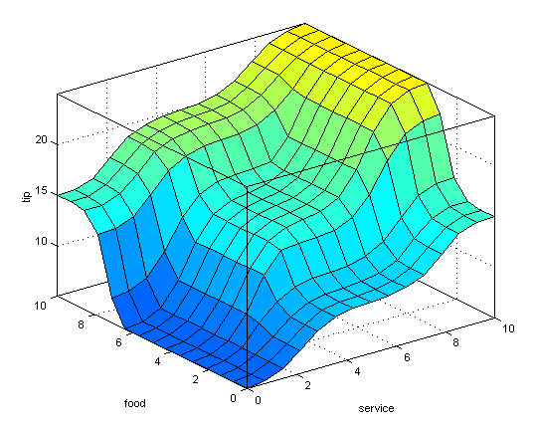
Tipping problem: fuzzy solution
Decision function generated using the 3 rules.

Slide 14
Tipping problem: fuzzy solution
Before we have a fuzzy solution we need to find out
how to define terms such as poor, delicious, cheap, generous etc.
how to combine terms using AND, OR and other connectives
how to combine all the rules into one final output

Slide 15
Fuzzy sets
Boolean/Crisp set A is a mapping for the elements of S to the set {0, 1}, i.e., A: S → {0, 1}
Characteristic function:
μ_{A}(x) =
{
1 if x is an element of set A
0 if x is not an element of set A
Fuzzy set F is a mapping for the elements of S to the interval [0, 1], i.e., F: S → [0, 1]
Characteristic function: 0 ≤ μ_{F}(x) ≤ 1
1 means full membership, 0 means no membership and anything in between, e.g., 0.5 is called graded membership

Slide 16
Example: Crisp set Tall
Fuzzy sets and concepts are commonly used in natural language
John is tall
Dan is smart
Alex is happy
The class is hot
E.g., the crisp set Tall can be defined as {x | height x > 1.8 meters}
But what about a person with a height = 1.79 meters?
What about 1.78 meters?
…
What about 1.52 meters?

Slide 17
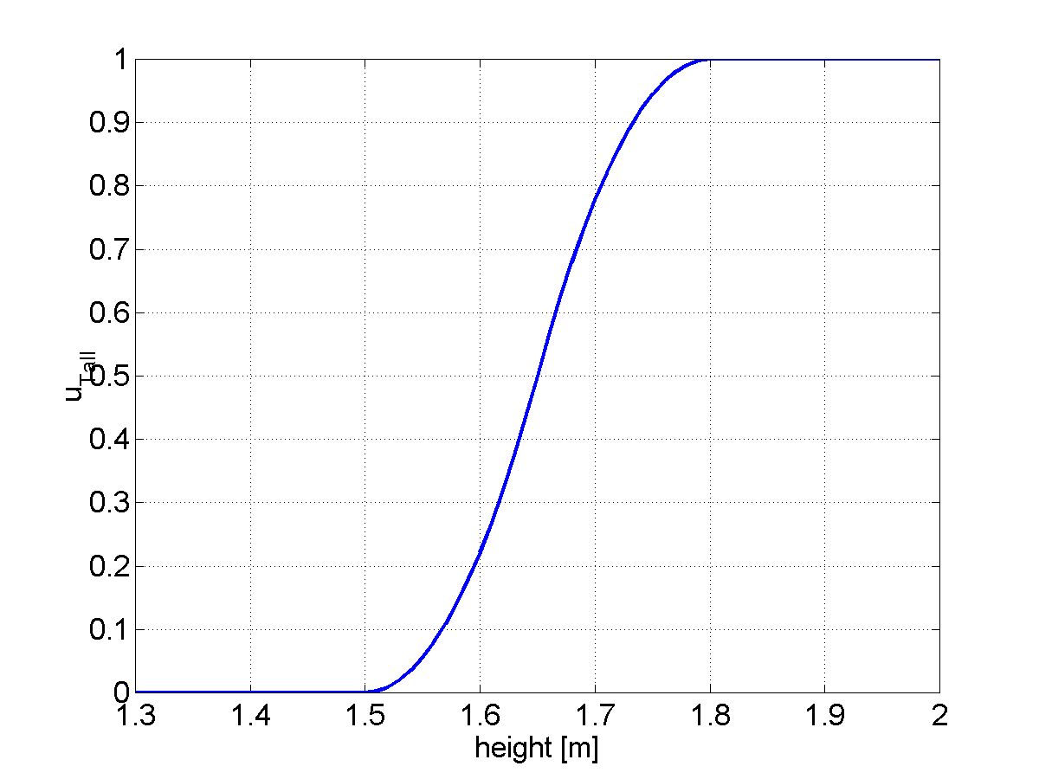
Example: Fuzzy set Tall
In a fuzzy set a person with a height of 1.8 meters would be considered tall to a high degree
A person with a height of 1.7 meters would be considered tall to a lesser degree etc.
The function can change
for basketball players,
Danes, women,
children etc.

Slide 18
Membership functions: S-function
The S-function can be used to define fuzzy sets
S(x, a, b, c) =
  0 for x ≤ a
  2(x-a/c-a)² for a ≤ x ≤ b
  1 – 2(x-c/c-a)² for b ≤ x ≤ c
  1 for x ≥ c
a
b
c

Slide 19
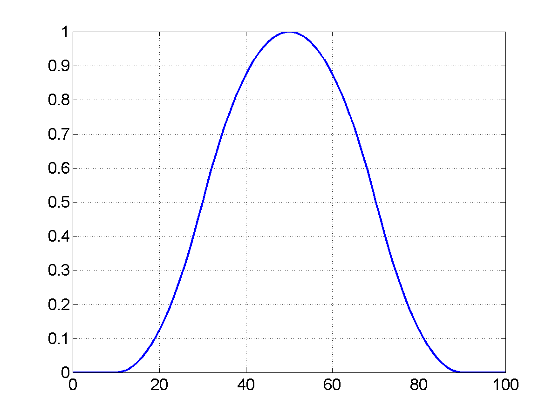
Membership functions: Π−Function
Π(x, a, b) =
  S(x, b-a, b-a/2, b) for x ≤ b
  1 – S(x, b, b+a/2, a+b) for x ≥ b
E.g., close (to a)
a
b-a
b-a/2
a
b+a/2
b+a

Slide 20
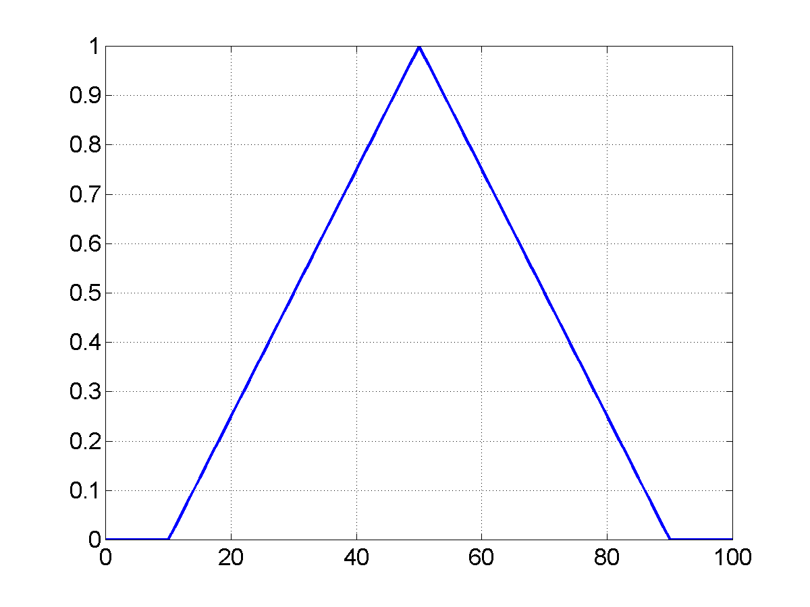
Simple membership functions
Piecewise linear: triangular etc.
Easier to represent and calculate ⇒ saves computation

Slide 21
Other representations of fuzzy sets
A finite set of elements:
F = μ₁/x₁ + μ₂/x₂ + … μ_{n}/x_{n}
+ means (Boolean) set union
For example:
TALL = {0/1.0, 0/1.2, 0/1.4, 0.2/1.6, 0.8/1.7, 1.0/1.8}

Slide 22
Fuzzy set operators
Equality
A = B
μ_{A} (x) = μ_{B} (x) for all x ∈ X
Complement
A’
μ_{A’} (x) = 1 - μ_{A}(x) for all x ∈ X
Containment
A ⊆ B
μ_{A} (x) ≤ μ_{B} (x) for all x ∈ X
Union
A ∪B
μ_{A ∪ B} (x) = max(μ_{A} (x), μ_{B} (x)) for all x ∈ X
Intersection
A ∩ B
μ_{A ∩ B} (x) = min(μ_{A} (x), μ_{B} (x)) for all x ∈ X

Slide 23
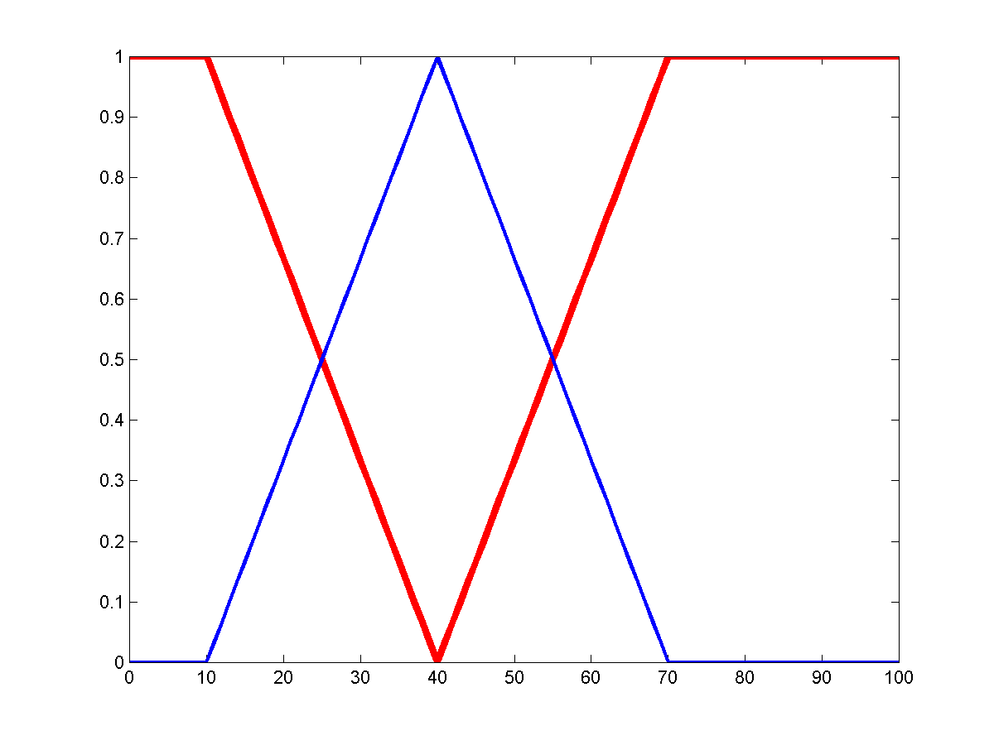
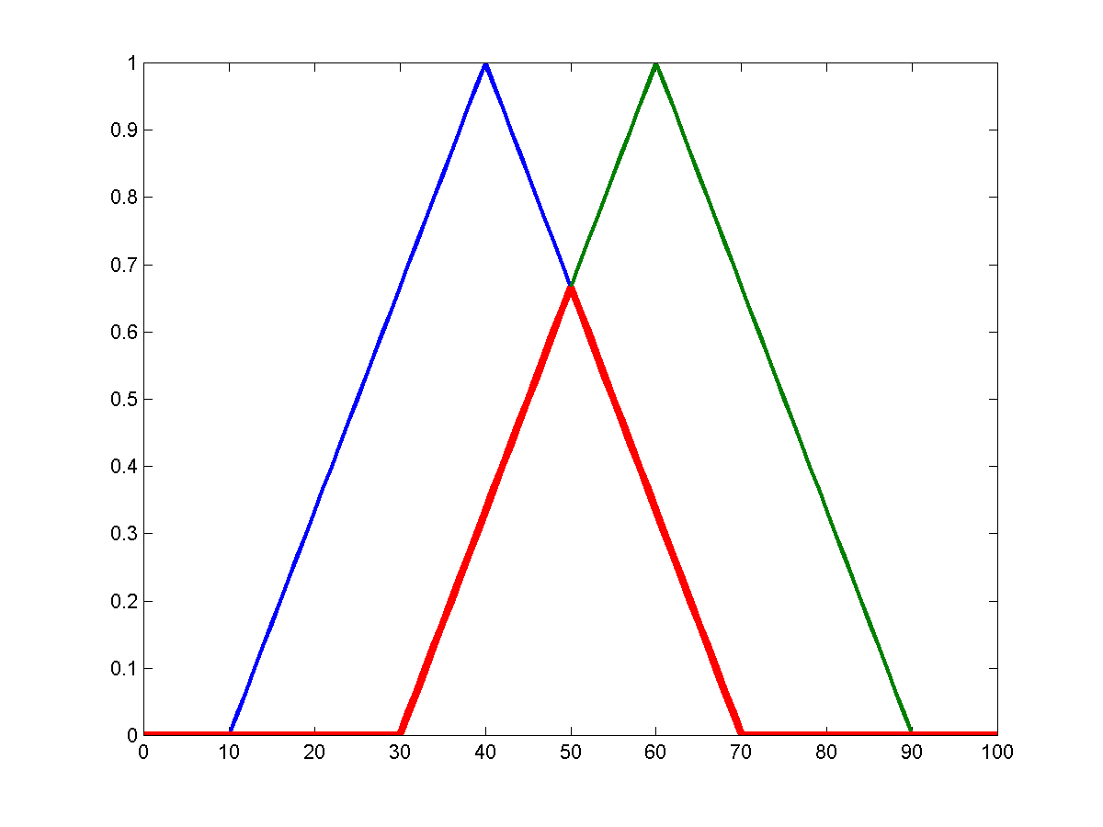
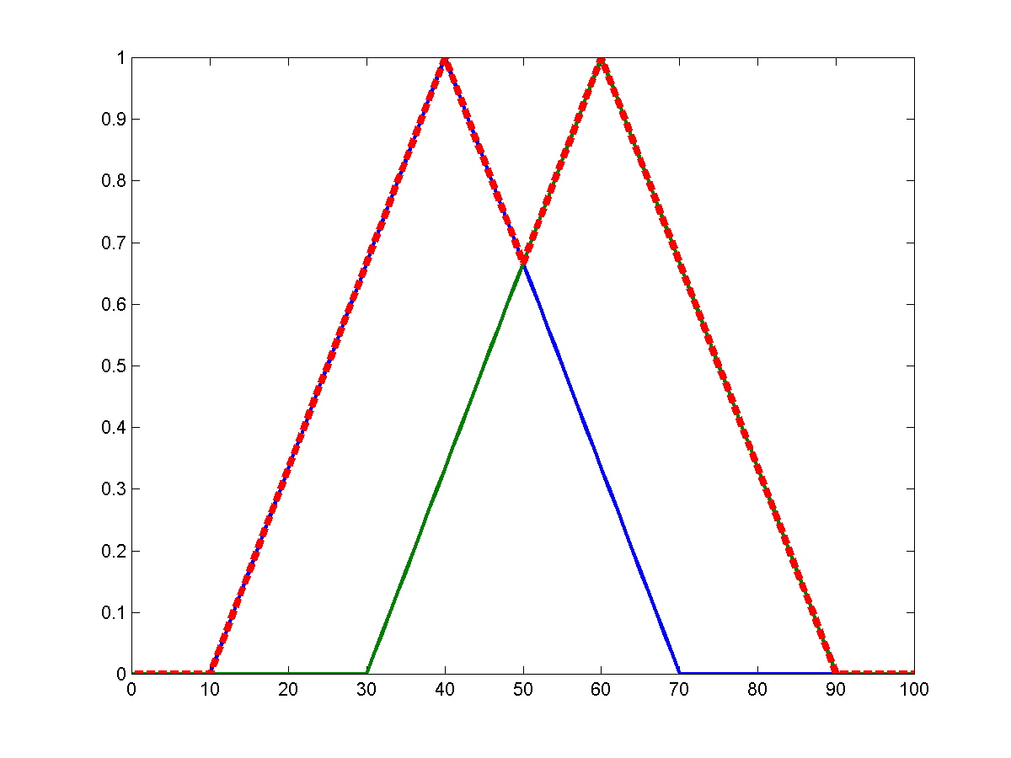
Example fuzzy set operations
A’
A
A ∩ B
A ∪ B
A
B

Slide 24
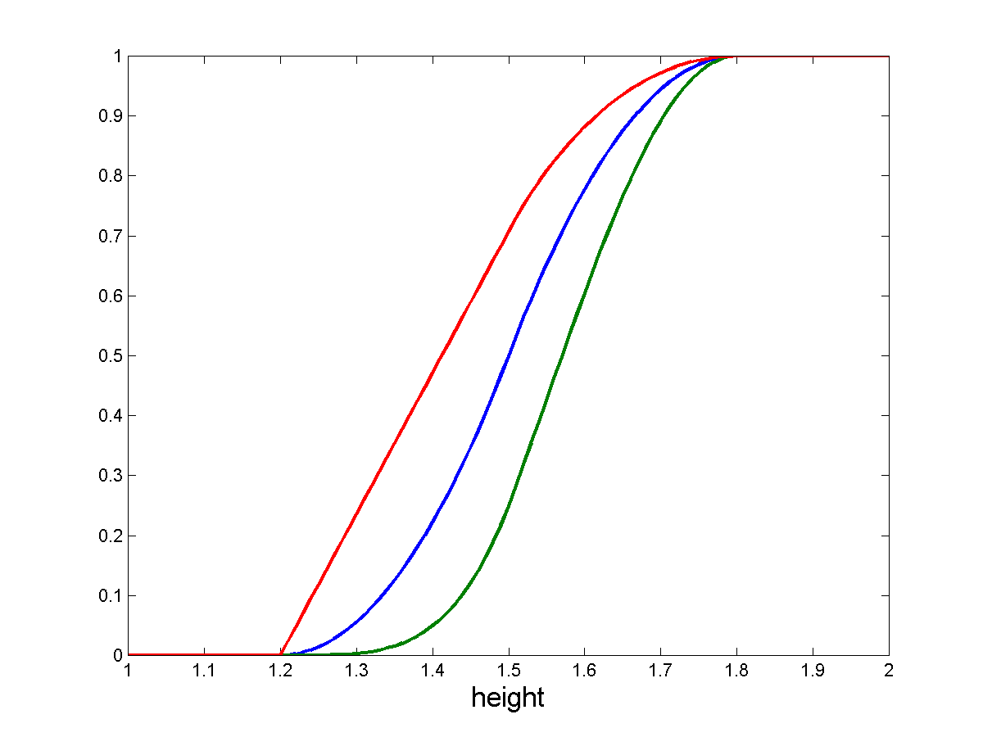
Linguistic Hedges
Modifying the meaning of a fuzzy set using hedges such as very, more or less, slightly, etc.
Very F = F²
More or less F = F^{1/2}
etc.
tall
More or less tall
Very tall

Slide 25
Fuzzy relations
A fuzzy relation for N sets is defined as an extension of the crisp relation to include the membership grade.
R = {μ_{R}(x₁, x₂, … x_{N})/(x₁, x₂, … x_{N}) | x_{i} ∈ X, i=1, … N}
which associates the membership grade, μ_{R} , of each tuple.
E.g.
Friend = {0.9/(Manos, Nacho), 0.1/(Manos, Dan),
0.8/(Alex, Mike), 0.3/(Alex, John)}

Slide 26
Fuzzy inference
Fuzzy logical operations
Fuzzy rules
Fuzzification
Implication
Aggregation
Defuzzification

Slide 27
Fuzzy logical operations
AND, OR, NOT, etc.
NOT A = A’ = 1 - μ_{A}(x)
A AND B = A ∩ B = min(μ_{A} (x), μ_{B} (x))
A OR B = A ∪ B = max(μ_{A} (x), μ_{B} (x))
From the following truth tables it is seen that fuzzy logic is a superset of Boolean logic.
min(A,B)
max(A,B)
1-A
A B A and B
0 0 0
0 1 0
0 0
1 1 1
A B A or B
0 0 0
0 1 1
0 1
1 1 1
A not A
0 1
1 0

Slide 28
If-Then Rules
Use fuzzy sets and fuzzy operators as the subjects and verbs of fuzzy logic to form rules.
if x is A then y is B
where A and B are linguistic terms defined by fuzzy sets on the sets X and Y respectively.
This reads
if x == A then y = B

Slide 29
Evaluation of fuzzy rules
In Boolean logic: p ⇒ q
if p is true then q is true
In fuzzy logic: p ⇒ q
if p is true to some degree then q is true to some degree.
0.5p => 0.5q (partial premise implies partially)
How?

Slide 30
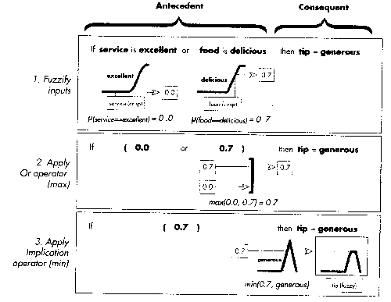
Evaluation of fuzzy rules (cont’d)
Apply implication function to the rule
Most common way is to use min to “chop-off” the consequent
(prod can be used to scale the consequent)

Slide 31
Summary: If-Then rules
Fuzzify inputs
Determine the degree of membership for all terms in the premise.
If there is one term then this is the degree of support for the consequence.
Apply fuzzy operator
If there are multiple parts, apply logical operators to determine the degree of support for the rule.
Apply implication method
Use degree of support for rule to shape output fuzzy set of the consequence.
How do we then combine several rules?

Slide 32
Multiple rules
We aggregate the outputs into a single fuzzy set which combines their decisions.
The input to aggregation is the list of truncated fuzzy sets and the output is a single fuzzy set for each variable.
Aggregation rules: max, sum, etc.
As long as it is commutative then the order of rule exec is irrelevant.

Slide 33
max-min rule of composition
Given N observations E_{i} over X and hypothesis H_{i} over Y we have N rules:
if E₁ then H₁
if E₂ then H₂
if E_{N} then H_{N}
μ_{H} = max[min(μ_{E1}), min(μ_{E2}), … min(μ_{EN})]

Slide 34
Defuzzify the output
Take a fuzzy set and produce a single crisp number that represents the set.
Practical when making a decision, taking an action etc.
Σ μ_{I} x
Σ μ_{I}
Center of gravity
I=
Center of largest area

Slide 35
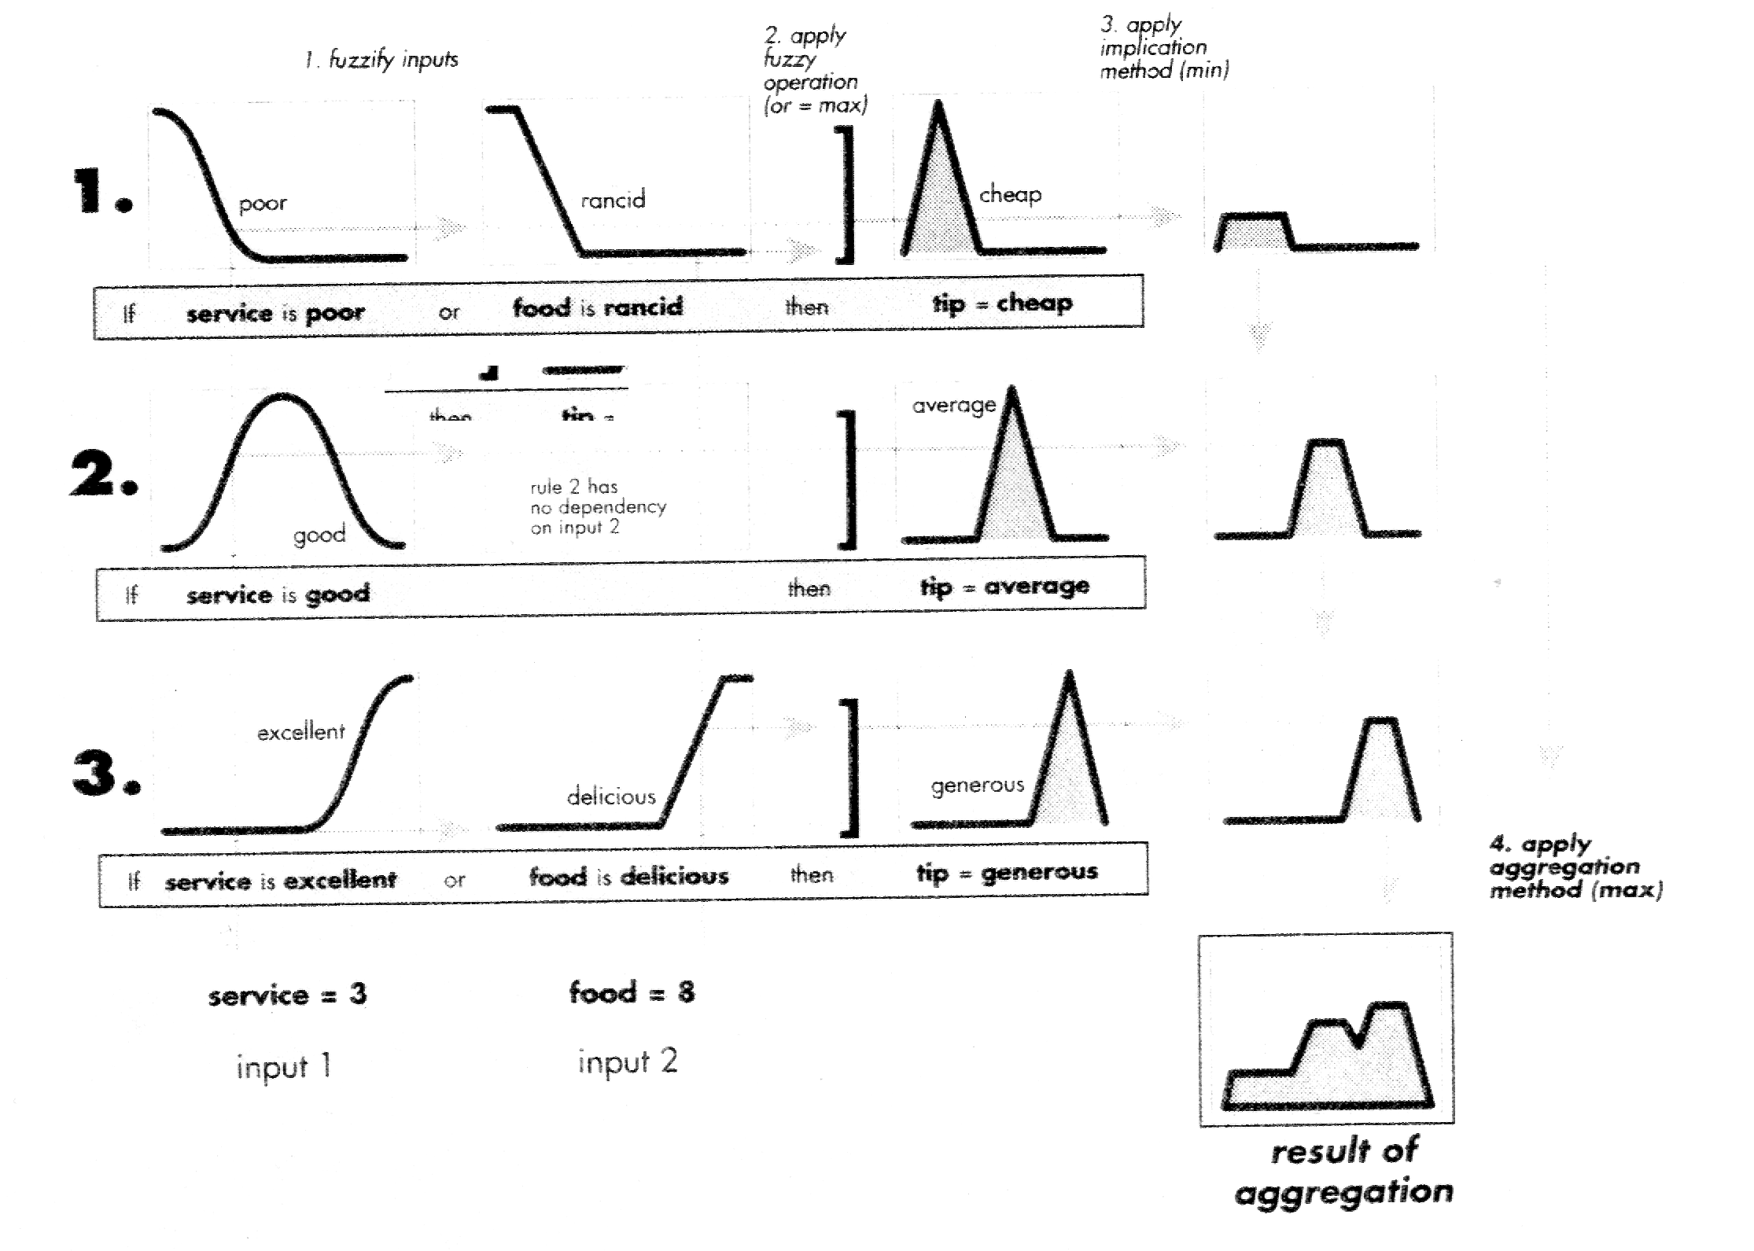
Fuzzy inference overview
Tip = 16.7 %
Result of defuzzification
(centroid)

Slide 36
Limitations of fuzzy logic
How to determine the membership functions? Usually requires fine-tuning of parameters
Defuzzification can produce undesired results

Slide 37
Fuzzy tools and shells
Matlab’s Fuzzy Toolbox
FuzzyClips
Etc.

